Slide 1
The Influence of the Urban Built-Environment on Predicting Obesity Rates in New York City
Ruoru Feng rf2463@nyu.edu, Tao Liang tl3517@nyu.edu,
Wengan Xiao wx2066@nyu.edu, Zirui Liu zl3547@nyu.edu
05 . 05 . 2 2

Slide 2
Background
P A R T 0 1

Slide 3
Built Environment & Obesity
P A R T 0 1
Built Environment is a conceptually important determinant of obesity in the past decades
Although most of the study have not yet confirmed the impact of built environment on obesity, many studies had shown that their features have influence on obesity.
In our project we use historical obesity rate in NYC as our target variable and built environment features as independent variables.
Our project will gives policymakers and urban planners a measurable idea of how to utilizing urban resources and take action to the vulnerable neighborhoods.
Notes:
By identifying the quantitative relationship between urban planning decisions and the health status of the residents
Our project will gives policymakers and urban planners a measurable idea of how to utilizing urban resources and take action to the neighborhoods.

Slide 4
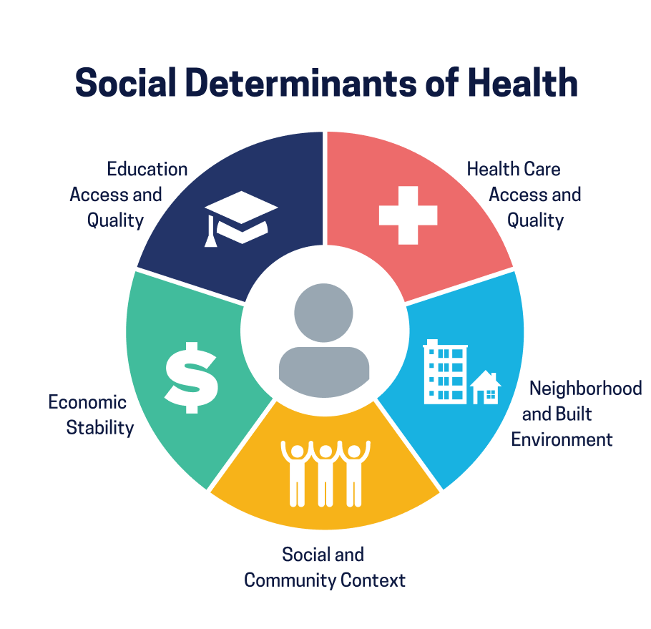
SDOH
P A R T 0 1
Social determinants of health (SDOH) are the conditions in the environments where people are born, live, learn, work, play, worship, and age that affect a wide range of health, functioning, and quality-of-life outcomes and risks.
Notes:
In our project, we will use the feature that mentioned in the Social Determinants of Health.
SDOH are non-medical feature that affect residents health such as Built environment, income, education and social
We want to find out how well these features performance in our prediction model, especially the built environment

Slide 5
Data
P A R T 0 2

Slide 6
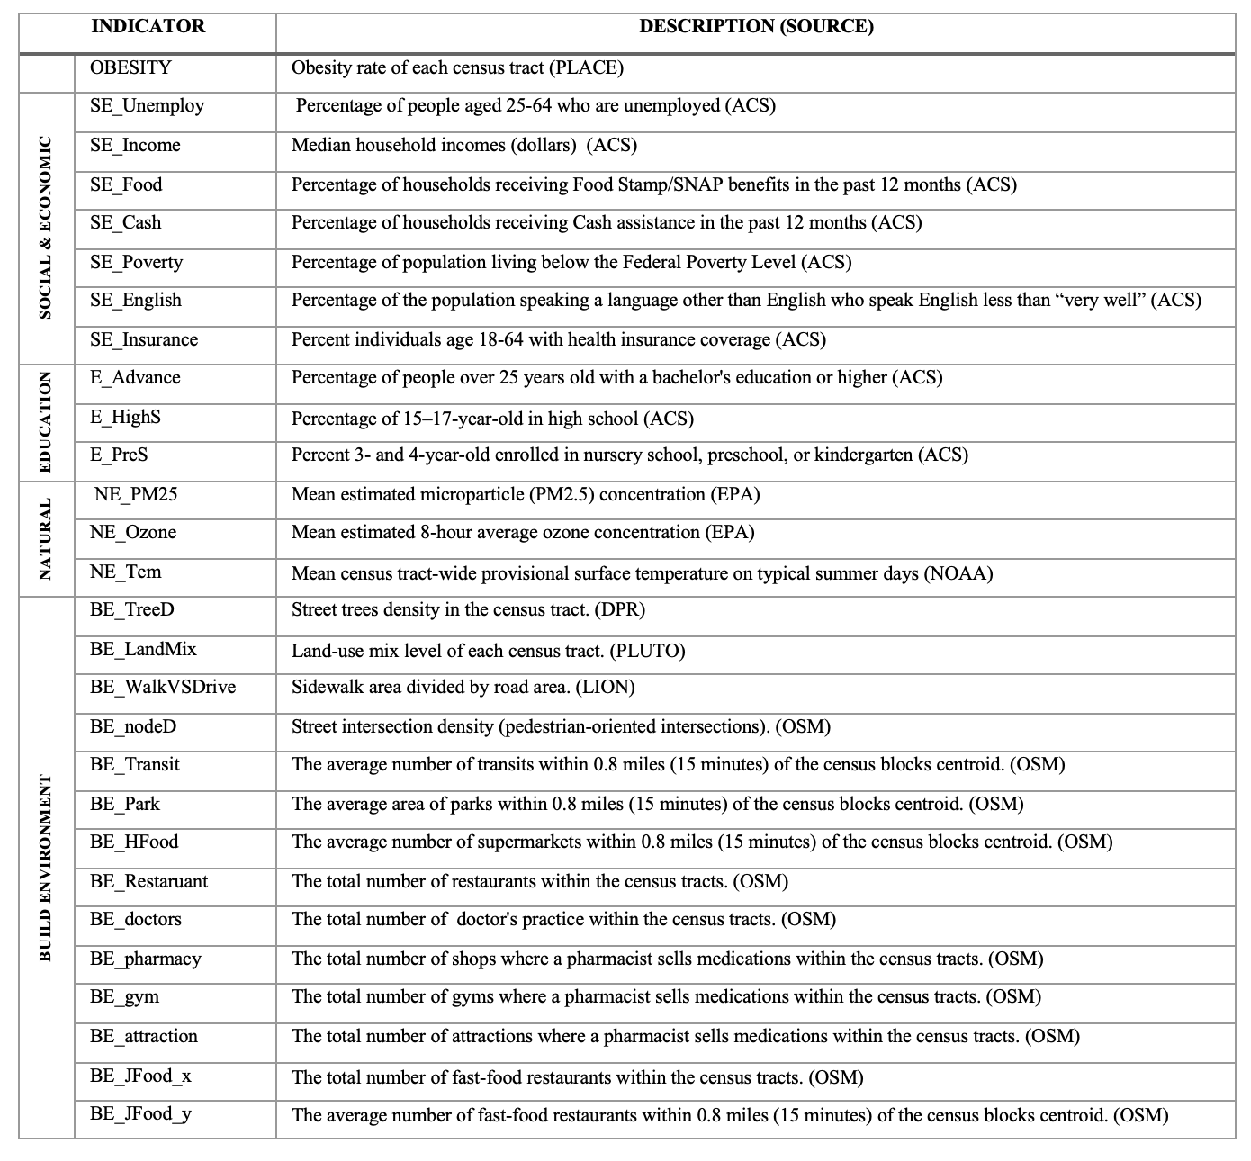
Data
P A R T 0 2
Units:
Census Tracts
(2003 out of 2165, population >= 1000)
Obesity Rate (CDC, 2019)
Socio-economic Data (ACS 5, 2019)
Education Data (ACS 5, 2019)
Natural Environment (EPA, NASA)
Built Environment (OSM, LION, PLUTO)

Slide 7
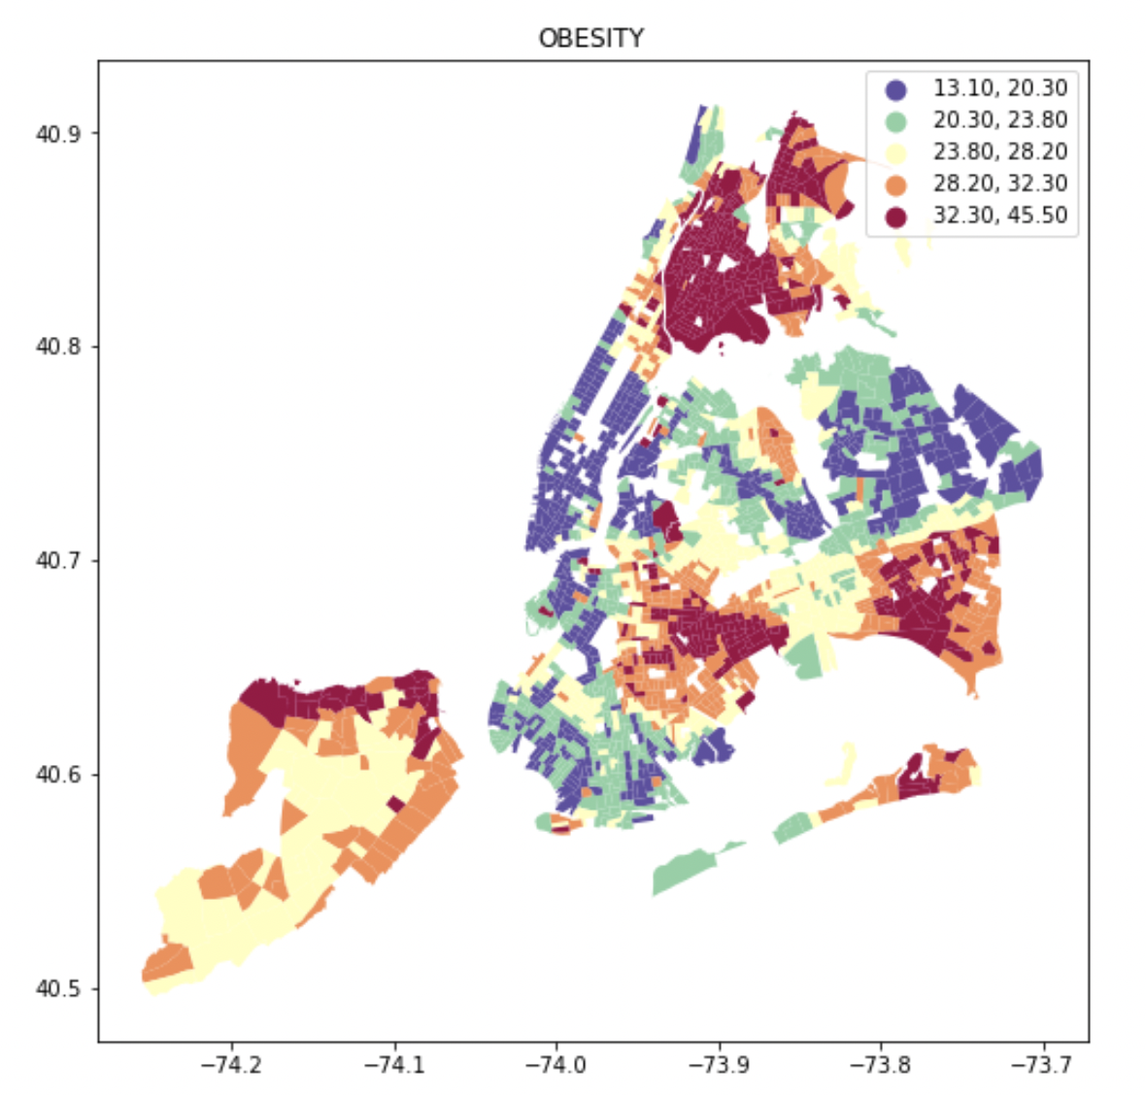
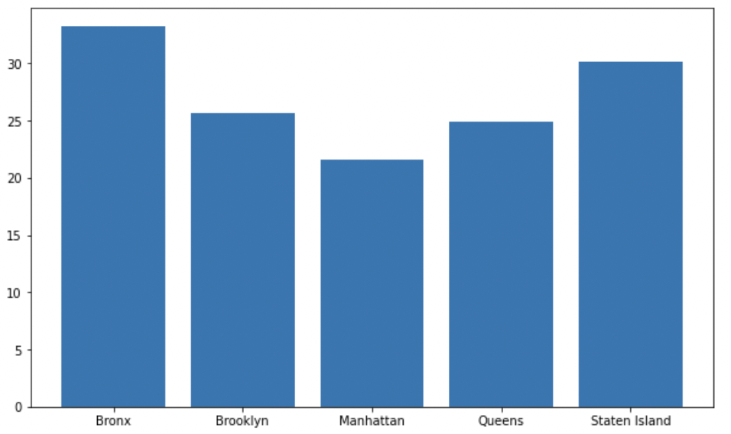
Obesity Rate
P A R T 0 2
Mean: 26.38%
Standard Deviation: 6.2%
Min: 13.10%
Max: 45.5%

Slide 8
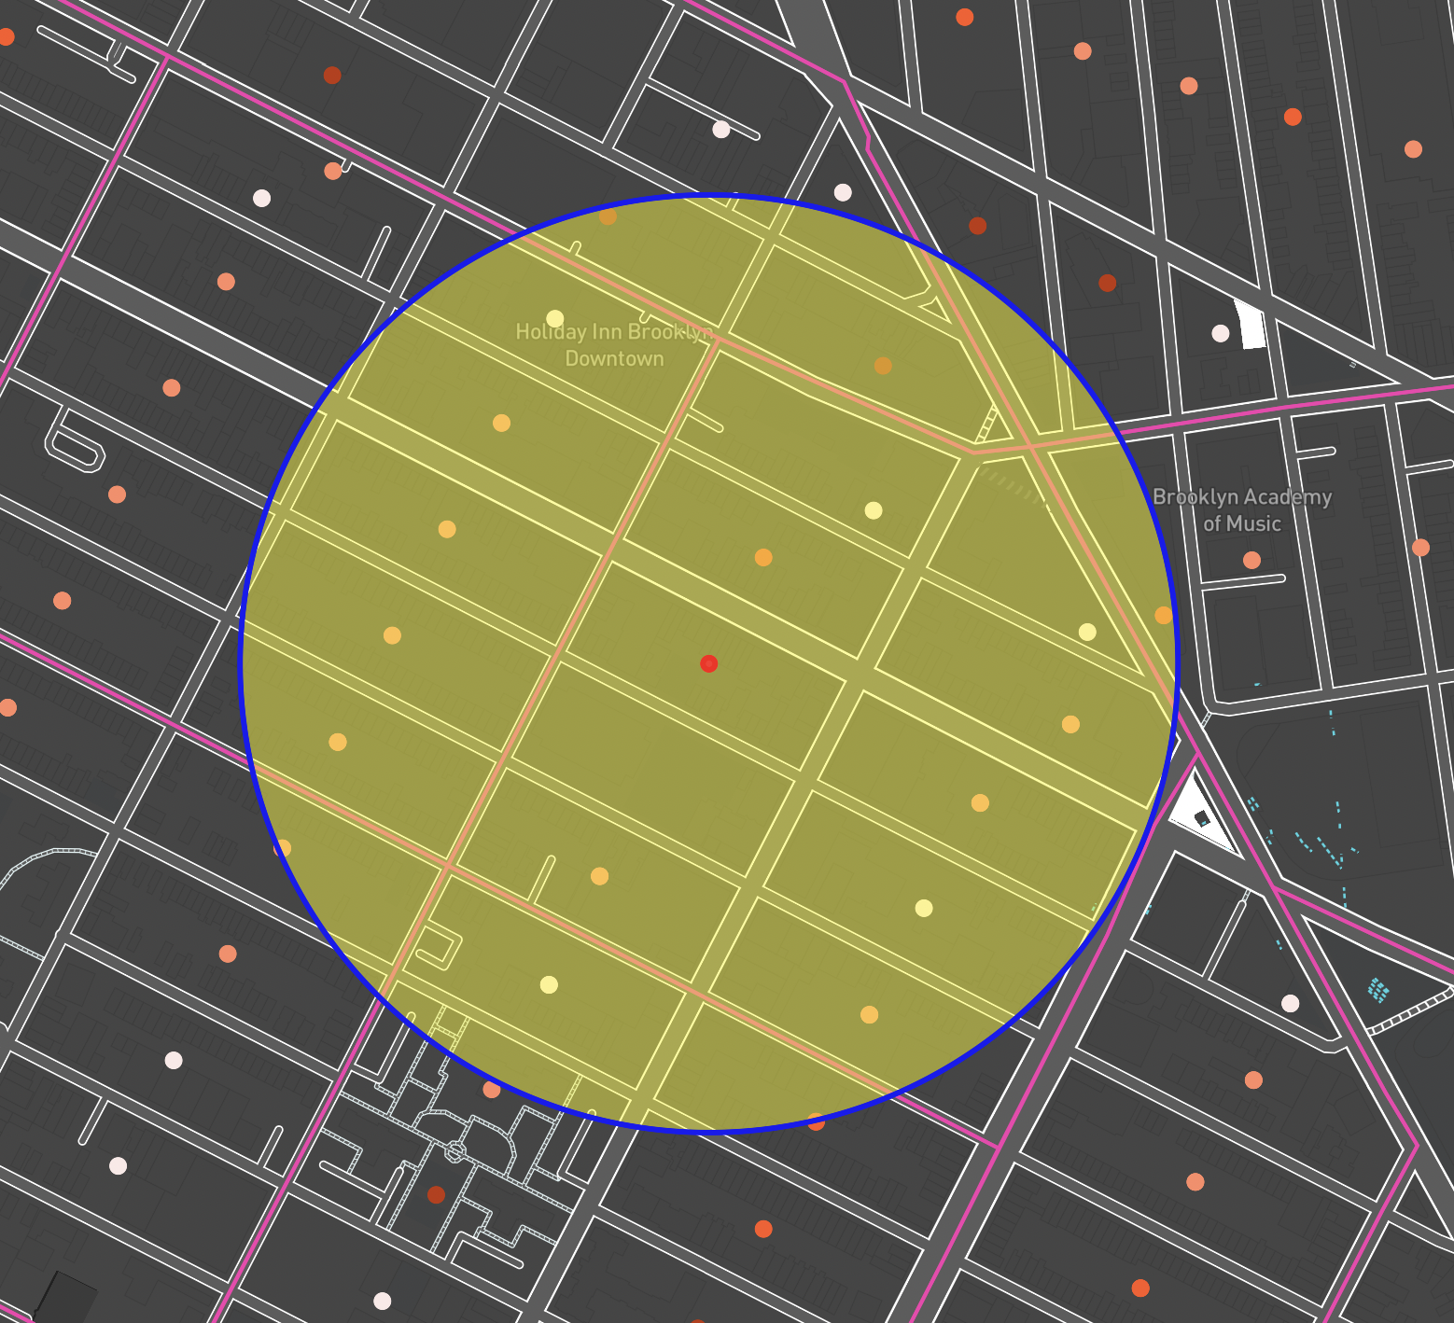
Feature in 15 min Walking Distance (0.8 mile)
P A R T 0 2
We draw a circle with the centroid of each census block and the radius of 0.8.
We calculate total number of the built environment characteristics that falls into the range.
And take the mean value of them.
Supermarkets
Fast-food restaurants
Park area
Transit

Slide 9
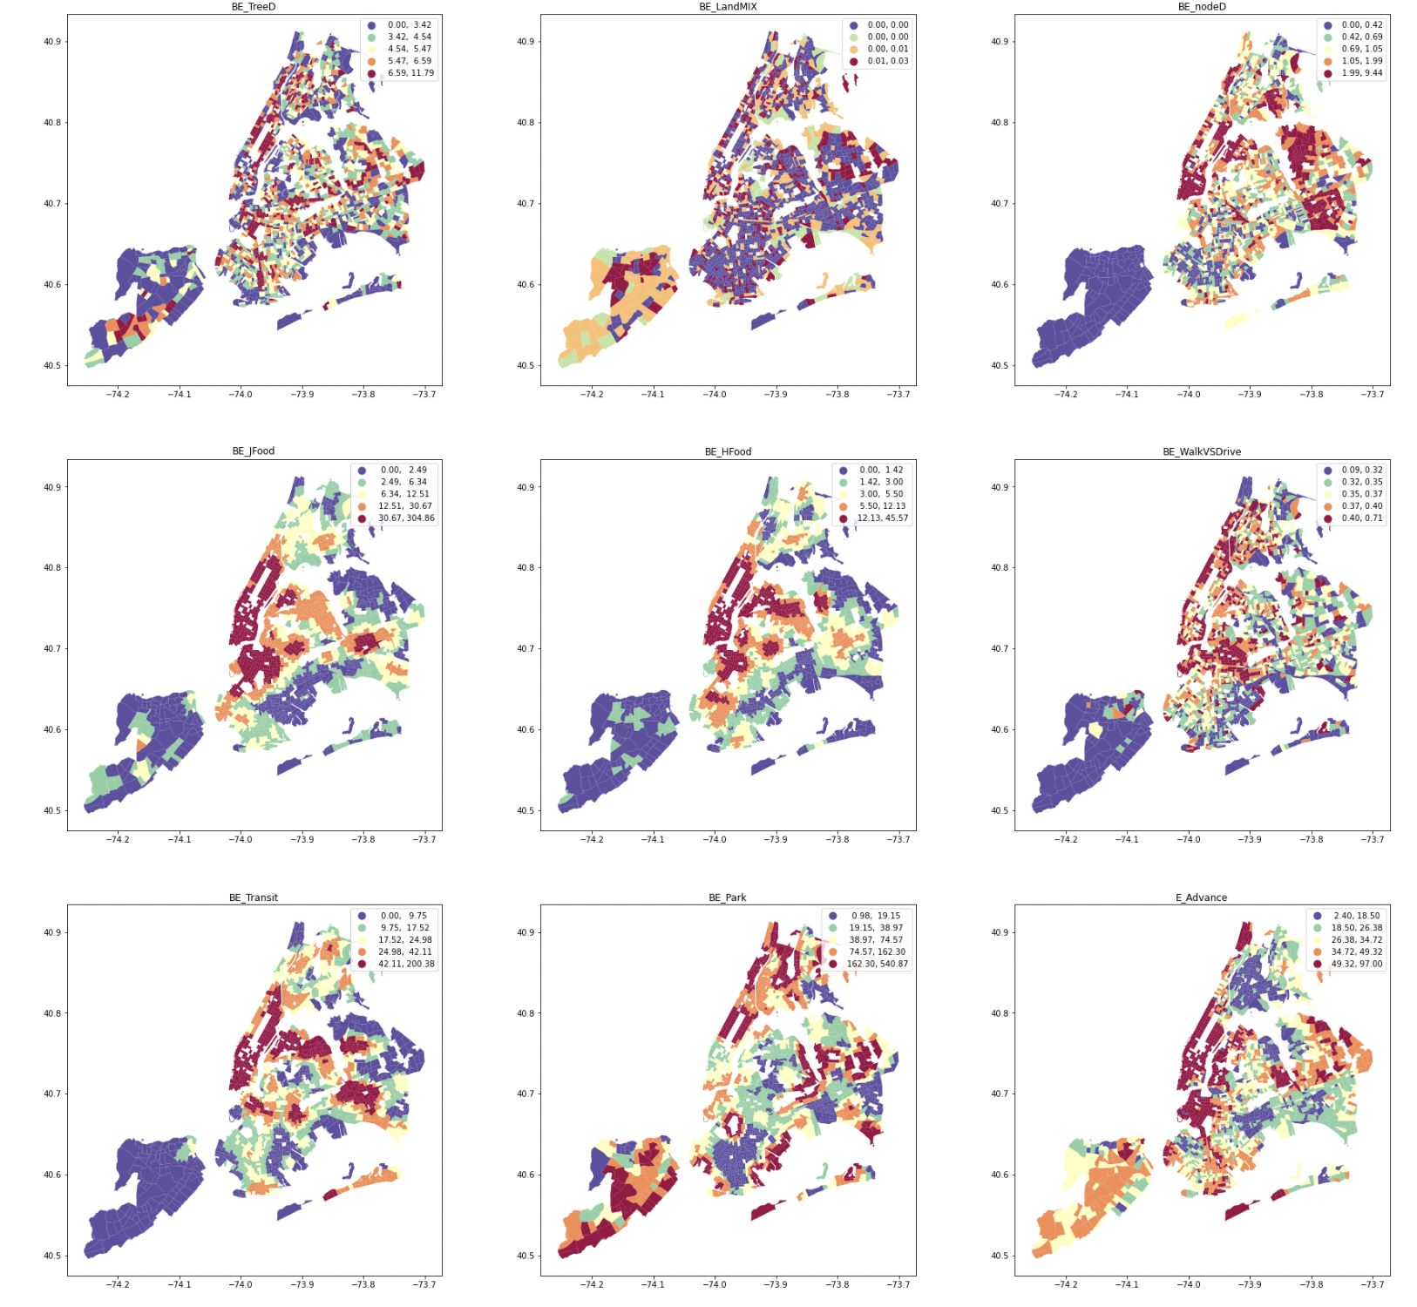
Data Heat Map
P A R T 0 2

Slide 10
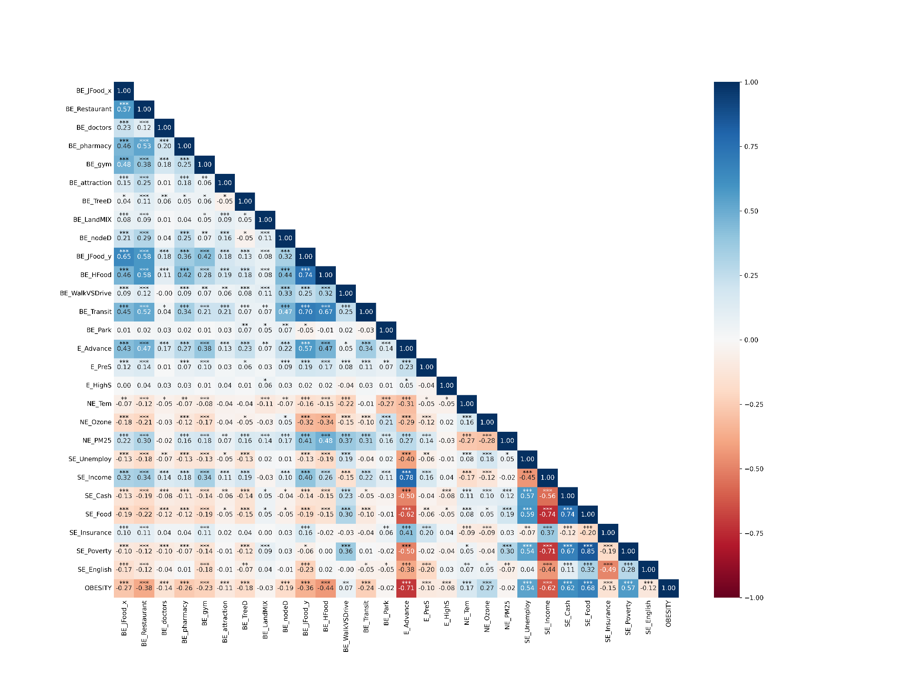
Pearson correlation coefficient
P A R T 0 2
P-Value:
* < 0.05
** < 0.01
*** < 0.001

Slide 11
Models
P A R T 0 3

Slide 12
Machine Learning Process
P A R T 03
Stage 1: Non-built environment factors — Use feature correlation
Stage 2: Built environment factors — combine the feature correlations and feature importance function to filter out all the features to constitute the built environment variables
Stage 3: Combined dataset of non-built environment factors (Stage 1) + built environment factors (Stage 2), and comparing the results with Stage 1

Slide 13
Without Building Environment
With Building Environment
P A R T 03
Model | Score | MAE
Decision Tree | 0.74 | 2.31
Random Forest | 0.84 | 1.83
Neural Network |  | 1.79
Model | Score | MAE
Decision Tree | 0.75 | 2.22
Random Forest | 0.87 | 1.64
Neural Network |  | 1.56

Slide 14
Results
P A R T 0 4

Slide 15



SHAP
P A R T 0 4
SHapley Additive exPlanation
Game Theory
Model Interpretation Tool
Feature - SHAP value
Notes:
Before we talk about our results, we have to introduce a tool named SHAP.
Its name comes from the SHapley Additive explanation in the research of game theory, it is a package that can interpret the output of any machine learning model.
SHAP builds a model where all features are considered "contributors" and give each feature a SHAP value.
We can use this value to evaluate the importance of features and their correlations with obesity.

Slide 16
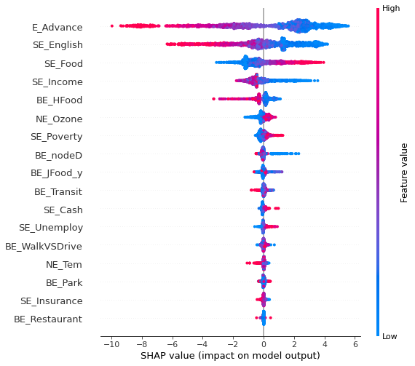
Features impacts
With BE
P A R T 04
Notes:
First, let me introduce the basic attribute of this graph.
For the color, the more red a point is, means the feature value is higher.
For the horizontal axis, the positive value means a positive correlation with obesity. The higher value means a more significant correlation.
So we can see that, in general, Non built environment has a more significant correlation with obesity than built environment.
For example, the Advance represents the education level, so we can say that when a district’s education level is higher, there are lower obesity. That’s consistent with our intuition.
Then let’s focus on the Built Environment:
For HFood and Transit which means supermarkets and transits density, there is a positive correlation with obesity.
Also, the distribution of supermarkets is the most significant among all built environment features.
For nodeD and JFood means pedestrian Intersection and junk food restaurants, there is a negative correlation with obesity.
At last, for the percentage of sidewalks, the park and restaurant density, there are no significant correlation with obesity.

Slide 17
Limitation
P A R T 0 5
The size of the data is relatively small with 2003 rows. The next step might be to consider investigating the obesity rate of entire U.S.
The improvement in model prediction is not significant might due to the built environment and obesity are rather indirectly related. For example, built environment only encourage physical activities to change obesity rate.

Slide 18
Reference list
P A R T 0 5
Centers for Disease Control and Prevention. (2019). Places: Local Data for Better Health. https://www.cdc.gov/places/index.html
Levine, J. A. (2011). Poverty and obesity in the US. In Diabetes (Vol. 60, Issue 11, pp. 2667–2668). Am Diabetes Assoc.
Shrider, E. A., Kollar, M., Chen, F., & Semega, J. (2021). Income and poverty in the United States: 2020. Current Population Reports. US Census Bureau, 14.
World Health Organization. (2010). A conceptual framework for action on the social determinants of health. 76. https://apps.who.int/iris/handle/10665/44489
Lundberg, S. M., & Lee, S. I. (2017). A unified approach to interpreting model predictions. Advances in neural information processing systems, 30.

Slide 19
Thank You!

